Slide 1
Introduction to Divide and Conquer Algorithm
Divide and Conquer Algorithm is a problem-solving technique used to solve problems by dividing the main problem into subproblems, solving them individually and then merging them to find solution to the original problem. A typical Divide and Conquer algorithm solves a problem using following three steps.
Divide: Break the given problem into sub-problems of same type.
Conquer: Recursively solve these sub-problems
Combine: Appropriately combine the answers
Slide No.

Slide 2
Working of Divide and Conquer Algorithm
Divide and Conquer Algorithm can be divided into three steps: Divide, Conquer and Merge .
1. Divide:
Break down the original problem into smaller subproblems.
Each subproblem should represent a part of the overall problem.
The goal is to divide the problem until no further division is possible.
2. Conquer:
Solve each of the smaller subproblems individually.
If a subproblem is small enough (often referred to as the “base case”), we solve it directly without further recursion.
The goal is to find solutions for these subproblems independently.
3. Merge:
Combine the sub-problems to get the final solution of the whole problem.
Once the smaller subproblems are solved, we recursively combine their solutions to get the solution of larger problem.
The goal is to formulate a solution for the original problem by merging the results from the subproblems.

Slide 3
Characteristics of Divide and Conquer Algorithm:
Divide and Conquer Algorithm involves breaking down a problem into smaller, more manageable parts, solving each part individually, and then combining the solutions to solve the original problem. The characteristics of Divide and Conquer Algorithm are:
Dividing the Problem: The first step is to break the problem into smaller, more manageable subproblems. This division can be done recursively until the subproblems become simple enough to solve directly.
Independence of Subproblems: Each subproblem should be independent of the others, meaning that solving one subproblem does not depend on the solution of another. This allows for parallel processing or concurrent execution of subproblems, which can lead to efficiency gains.
Conquering Each Subproblem: Once divided, the subproblems are solved individually. This may involve applying the same divide and conquer approach recursively until the subproblems become simple enough to solve directly, or it may involve applying a different algorithm or technique.
Combining Solutions: After solving the subproblems, their solutions are combined to obtain the solution to the original problem. This combination step should be relatively efficient and straightforward, as the solutions to the subproblems should be designed to fit together seamlessly.

Slide 4
Complexity Analysis of Divide and Conquer Algorithm:
T(n) = aT(n/b) + f(n)
where n = size of input a = number of subproblems in the recursion n/b = size of each subproblem. All subproblems are assumed to have the same size. f(n) = cost of the work done outside the recursive call, which includes the cost of dividing the problem and cost of merging the solutions

Slide 5
Applications of Divide and Conquer Algorithm:
The following are some standard algorithms that follow Divide and Conquer algorithm:
Quicksort is a sorting algorithm that picks a pivot element and rearranges the array elements so that all elements smaller than the picked pivot element move to the left side of the pivot, and all greater elements move to the right side. Finally, the algorithm recursively sorts the subarrays on the left and right of the pivot element.
Merge Sort is also a sorting algorithm. The algorithm divides the array into two halves, recursively sorts them, and finally merges the two sorted halves.
Closest Pair of Points The problem is to find the closest pair of points in a set of points in the x-y plane. The problem can be solved in O(n^2) time by calculating the distances of every pair of points and comparing the distances to find the minimum. The Divide and Conquer algorithm solves the problem in O(N log N) time.
Strassen’s Algorithm is an efficient algorithm to multiply two matrices. A simple method to multiply two matrices needs 3 nested loops and is O(n^3). Strassen’s algorithm multiplies two matrices in O(n^2.8974) time.

Slide 6
Cont…
A classic example of Divide and Conquer is Merge Sort demonstrated below. In Merge Sort, we divide array into two halves, sort the two halves recursively, and then merge the sorted halves.
The following are some standard algorithms that follows Divide and Conquer algorithm.
Binary Search
Quick sort
Merge Sort
Closest Pair of Points
Slide No.

Slide 7
Binary Search
Binary search is a search algorithm used to find the position of a target value within a sorted array. It works by repeatedly dividing the search interval in half until the target value is found or the interval is empty. The search interval is halved by comparing the target element with the middle value of the search space.
Conditions to apply Binary Search Algorithm in a Data Structure:
To apply Binary Search algorithm:
The data structure must be sorted.
Access to any element of the data structure should take constant time.
Binary Search Algorithm
Divide the search space into two halves by finding the middle index “mid”.
Compare the middle element of the search space with the key.
If the key is found at middle element, the process is terminated.
If the key is not found at middle element, choose which half will be used as the next search space.
If the key is smaller than the middle element, then the left side is used for next search.
If the key is larger than the middle element, then the right side is used for next search.
This process is continued until the key is found or the total search space is exhausted.

Slide 8
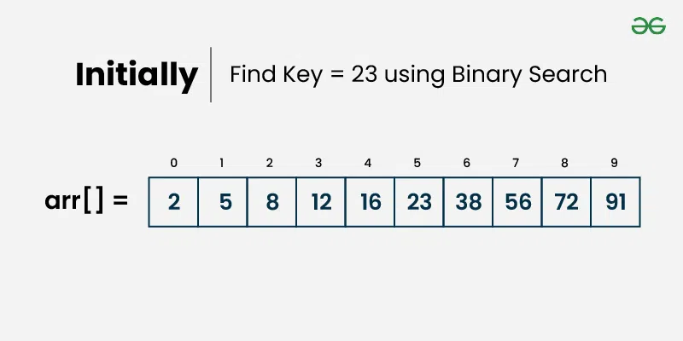
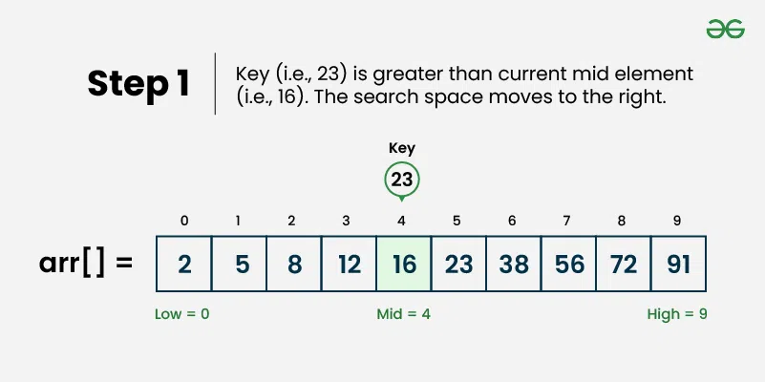
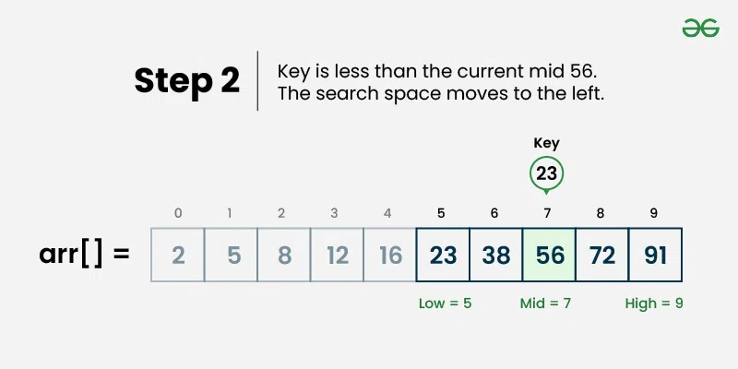
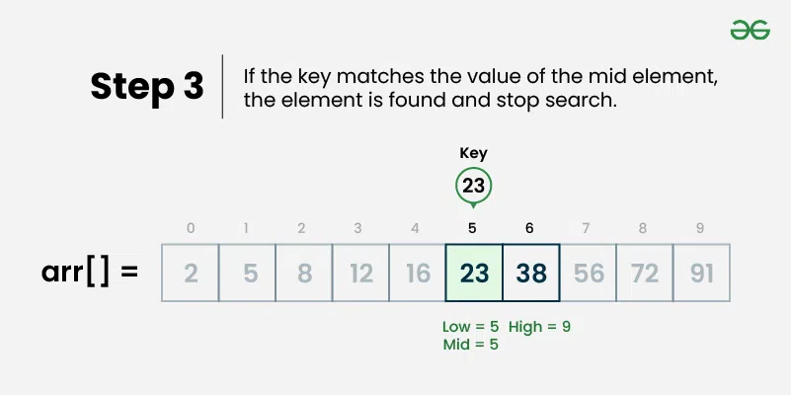
How does Binary Search Algorithm work?
Consider an array arr[] = {2, 5, 8, 12, 16, 23, 38, 56, 72, 91}, and the target = 23.

Slide 9
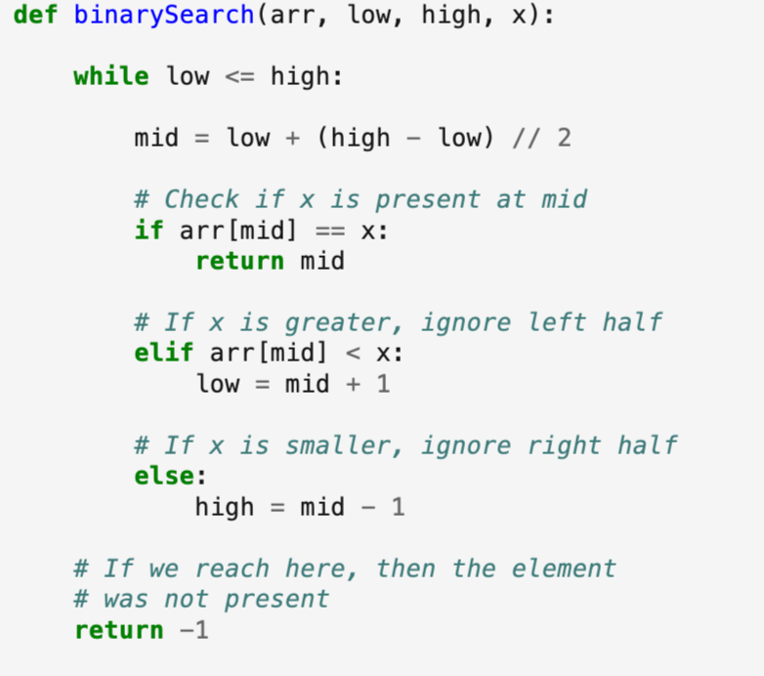
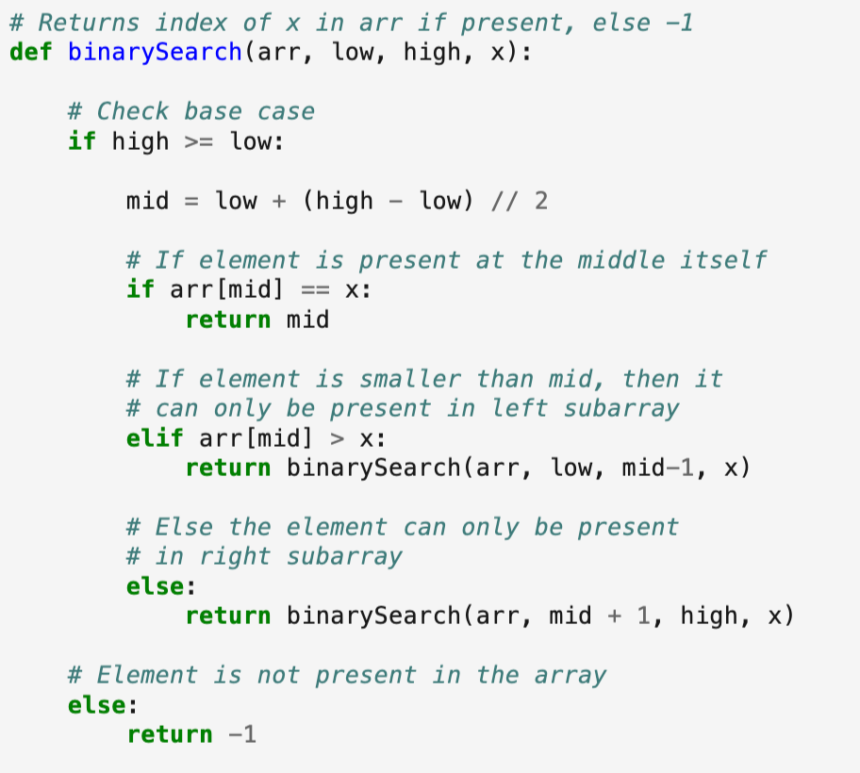
How to Implement Binary Search Algorithm?
The Binary Search Algorithm can be implemented in the following two ways
Iterative Binary Search Algorithm
Recursive Binary Search Algorithm
Iterative Binary Search Algorithm:
Recursive Binary Search Algorithm:

Slide 10
Complexity Analysis of Binary Search Algorithm:
Time Complexity:
Best Case: O(1)
Average Case: O(log N)
Worst Case: O(log N)
Auxiliary Space: O(1), If the recursive call stack is considered then the auxiliary space will be O(logN).
Applications of Binary Search Algorithm:
Binary search can be used as a building block for more complex algorithms used in machine learning, such as algorithms for training neural networks or finding the optimal hyperparameters for a model.
It can be used for searching in computer graphics such as algorithms for ray tracing or texture mapping.
It can be used for searching a database.

Slide 11
Advantages of Binary Search:
Binary search is faster than linear search, especially for large arrays.
More efficient than other searching algorithms with a similar time complexity, such as interpolation search or exponential search.
Binary search is well-suited for searching large datasets that are stored in external memory, such as on a hard drive or in the cloud.
Disadvantages of Binary Search:
The array should be sorted.
Binary search requires that the data structure being searched be stored in contiguous memory locations.
Binary search requires that the elements of the array be comparable, meaning that they must be able to be ordered.

Slide 12
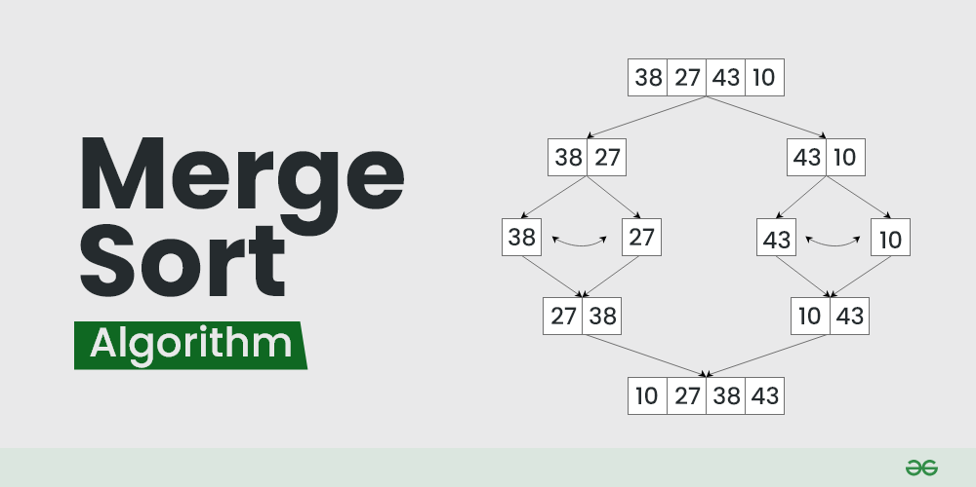
Merge Sort
Merge sort is a sorting algorithm that follows the divide-and-conquer approach. It works by recursively dividing the input array into smaller subarrays and sorting those subarrays then merging them back together to obtain the sorted array.

Slide 13
How does Merge Sort work?
Merge sort is a popular sorting algorithm known for its efficiency and stability. It follows the divide-and-conquer approach to sort a given array of elements.
Here’s a step-by-step explanation of how merge sort works:
Divide: Divide the list or array recursively into two halves until it can no more be divided.
Conquer: Each subarray is sorted individually using the merge sort algorithm.
Merge: The sorted subarrays are merged back together in sorted order. The process continues until all elements from both subarrays have been merged.

Slide 14
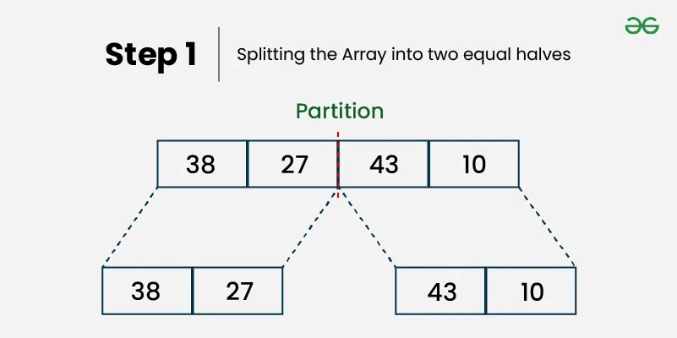
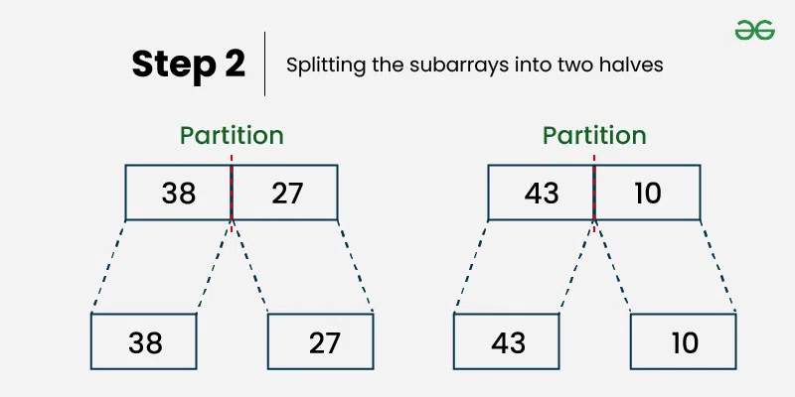
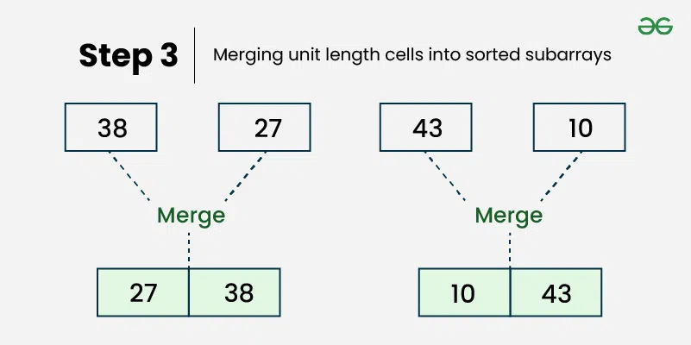
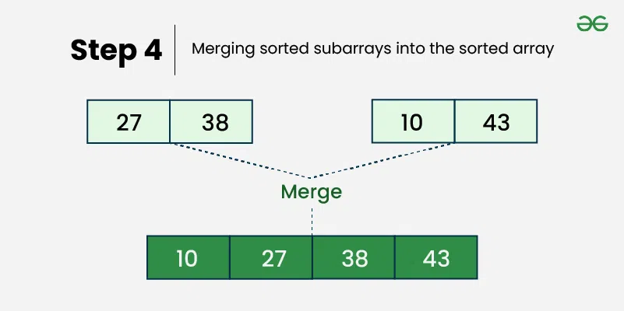
Illustration of Merge Sort

Slide 15
Complexity Analysis of Merge Sort:
Best Case: O(n log n), When the array is already sorted or nearly sorted.
Average Case: O(n log n), When the array is randomly ordered.
Worst Case: O(n log n), When the array is sorted in reverse order.
Space Complexity: O(n), Additional space is required for the temporary array used during merging.
Applications of Merge Sort:
Sorting large datasets
External sorting (when the dataset is too large to fit in memory)
Inversion counting (counting the number of inversions in an array)
Finding the median of an array

Slide 16
Advantages of Merge Sort:
Stability : Merge sort is a stable sorting algorithm, which means it maintains the relative order of equal elements in the input array.
Guaranteed worst-case performance: Merge sort has a worst-case time complexity of O(N logN) , which means it performs well even on large datasets.
Simple to implement: The divide-and-conquer approach is straightforward.
Disadvantages of Merge Sort:
Space complexity: Merge sort requires additional memory to store the merged sub-arrays during the sorting process.
Not in-place: Merge sort is not an in-place sorting algorithm, which means it requires additional memory to store the sorted data. This can be a disadvantage in applications where memory usage is a concern.

Slide 17
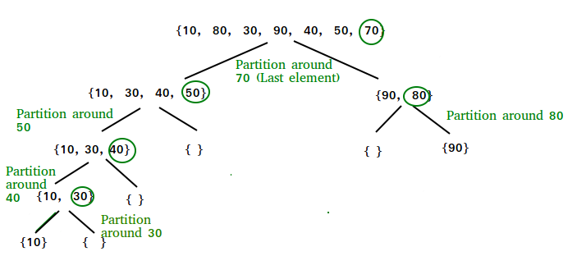
Quick Sort Algorithm
QuickSort is a sorting algorithm based on the Divide and Conquer algorithm that picks an element as a pivot and partitions the given array around the picked pivot by placing the pivot in its correct position in the sorted array.
How does QuickSort work?

Slide 18
The key process in quickSort is a partition() . The target of partitions is to place the pivot (any element can be chosen to be a pivot) at its correct position in the sorted array and put all smaller elements to the left of the pivot, and all greater elements to the right of the pivot.
Partition is done recursively on each side of the pivot after the pivot is placed in its correct position and this finally sorts the array.
Choice of Pivot:
There are many different choices for picking pivots.
Always pick the first element as a pivot .
Always pick the last element as a pivot (implemented below)
Pick a random element as a pivot .
Pick the middle as the pivot.
Partition Algorithm:
The logic is simple, we start from the leftmost element and keep track of the index of smaller (or equal) elements as i . While traversing, if we find a smaller element, we swap the current element with arr[i]. Otherwise, we ignore the current element.

Slide 19
Complexity Analysis of Quick Sort :
Best Case : Ω (N log (N)) The best-case scenario for quicksort occur when the pivot chosen at the each step divides the array into roughly equal halves. In this case, the algorithm will make balanced partitions, leading to efficient Sorting.
Average Case: θ ( N log (N)) Quicksort’s average-case performance is usually very good in practice, making it one of the fastest sorting Algorithm.
Worst Case: O(N2) The worst-case Scenario for Quicksort occur when the pivot at each step consistently results in highly unbalanced partitions. When the array is already sorted and the pivot is always chosen as the smallest or largest element
Auxiliary Space: O(1), if we don’t consider the recursive stack space. If we consider the recursive stack space then, in the worst case quicksort could make O ( N ).

Slide 20
Advantages of Quick Sort:
It is a divide-and-conquer algorithm that makes it easier to solve problems.
It is efficient on large data sets.
It has a low overhead, as it only requires a small amount of memory to function.
Disadvantages of Quick Sort:
It has a worst-case time complexity of O(N ² ), which occurs when the pivot is chosen poorly.
It is not a good choice for small data sets.
It is not a stable sort, meaning that if two elements have the same key, their relative order will not be preserved in the sorted output in case of quick sort, because here we are swapping elements according to the pivot’s position (without considering their original positions).

Slide 21
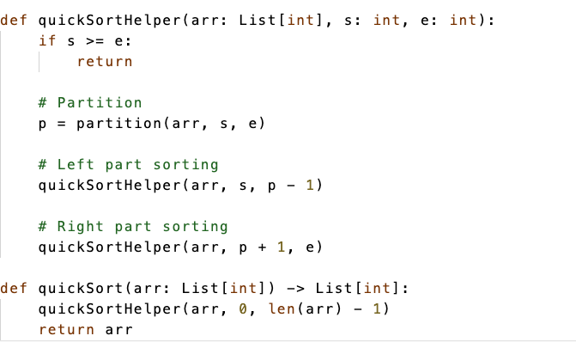
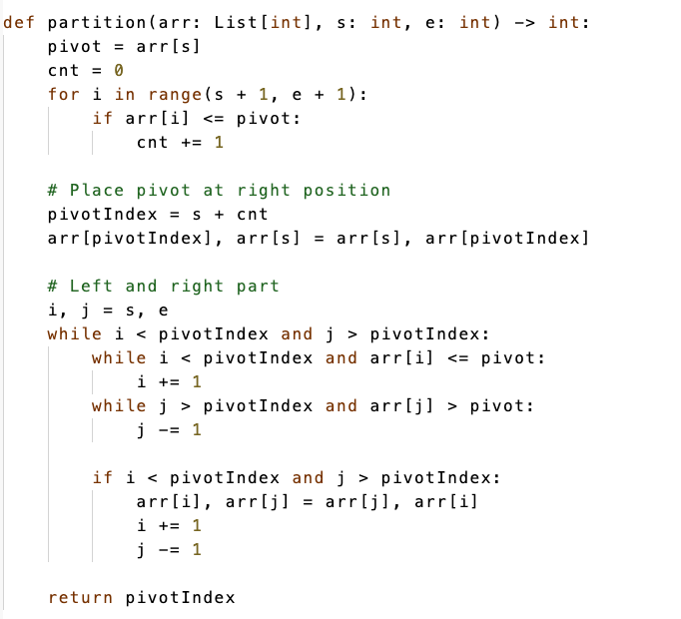
Quick Sort Code
Part 1
Part 2

